Slide 1


EE463: STATIC POWER CONVERSION I DC MOTOR DRIVE PROJECT FEEDBACK SESSION
CURRENT NAVIGATORS
Muhammet Kamer Taha GENÇ 2234748
Mustafa Burak ÇORUK 2442812
Öykü KAYAN 2516391

Slide 2
OUTLINE
Project Requirements
Topology Selection
Simulations
PWM Generator
Component Selection
Conclusion

Slide 3
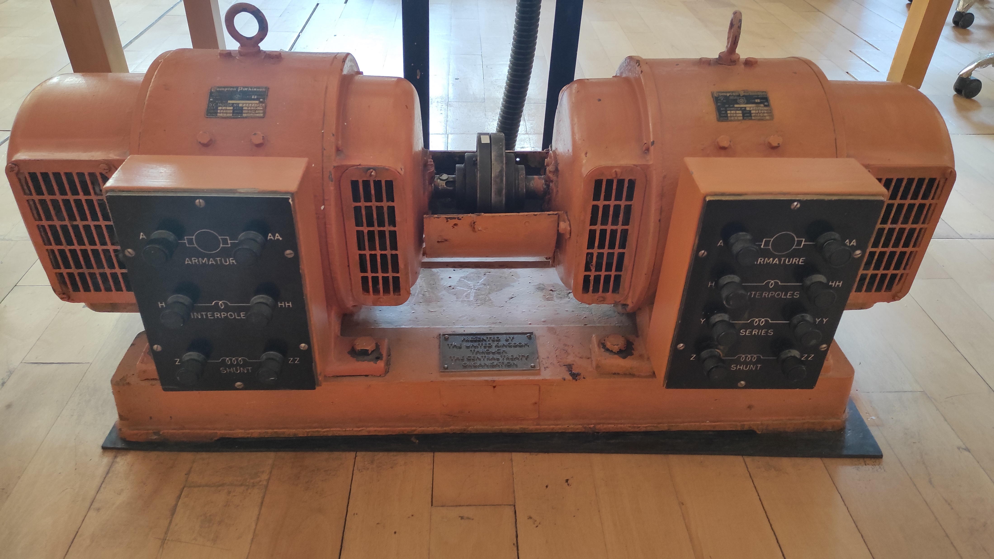
PROJECT REQUIREMENTS
Power Input: 3 Phase, or 1 Phase AC Grid (Adjustable with variac)
Output: Adjustable DC Output (Vout,max = 180 V)
Armature Winding: 0.8 Ω, 12.5 mH
Shunt WINDING: 210 Ω, 23 H
Interpoles Winding: 0.27 Ω, 12 mH

Slide 4
TOPOLOGY SELECTION
Single Phase Diode Rectifier
Advantages: Simple, cost-effective, suitable for low-power applications.
Disadvantages: High output ripple, limited efficiency at higher power levels.
Three Phase Diode Rectifier
Advantages: Higher output voltage, smoother DC output, efficient for high-power applications.
Disadvantages: More complex and costly than single-phase systems.
Single Phase Thyristor Rectifier
Advantages: Adjustable output voltage, low conduction losses, simple design.
Disadvantages: Requires control circuit, higher ripple.
Three Phase Thyristor Rectifier
Advantages: Higher and smoother output voltage, consistent power delivery.
Disadvantages: Complex control system, harmonic distortions, higher cost.

Slide 5
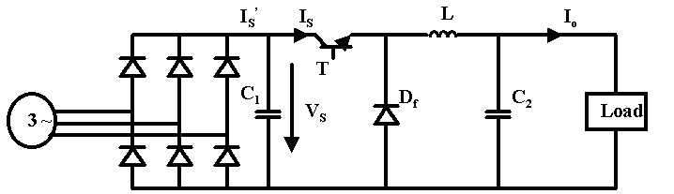
SELECTED TOPOLOGY
Three-Phase Diode Rectifier with Buck Converter
Combines high output voltage, smooth DC supply, and simplified control for efficient high-power motor applications.

Slide 6
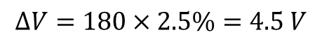
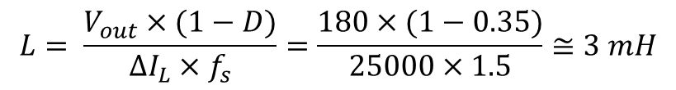
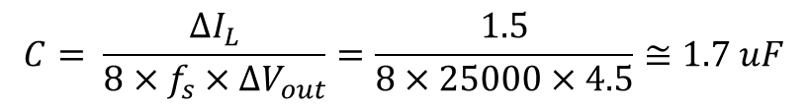
PARAMETER SELECTION FOR SIMULATIONS
$$L= \frac{V_{out}×(1−D)}{∆I_{L}×f_{s}}=\frac{180×(1−0.35)}{25000×1.5}≅3 mH$$
$$∆V=180×2.5\%=4.5 V$$
$$C= \frac{∆I_{L}}{8×f_{s}×∆V_{out}}=\frac{1.5}{8×25000×4.5}≅1.7 uF$$

Slide 7
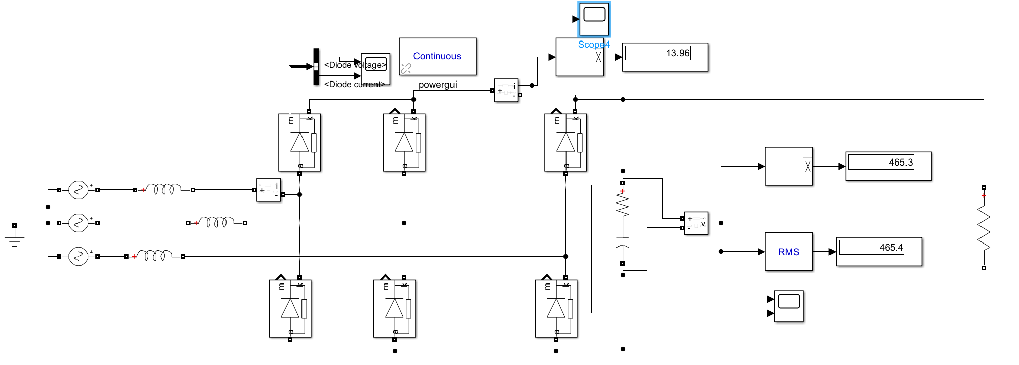
THREE PHASE DIODE RECTIFIER

Slide 8
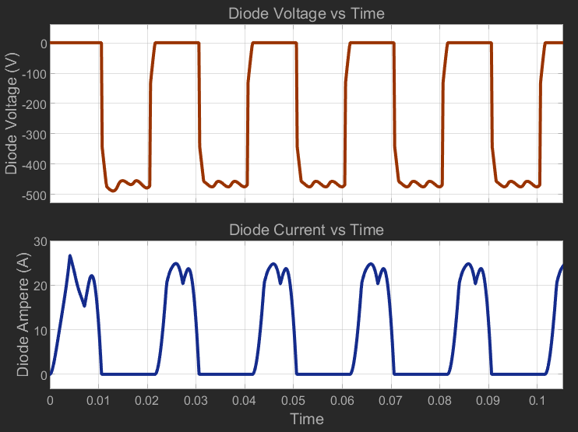
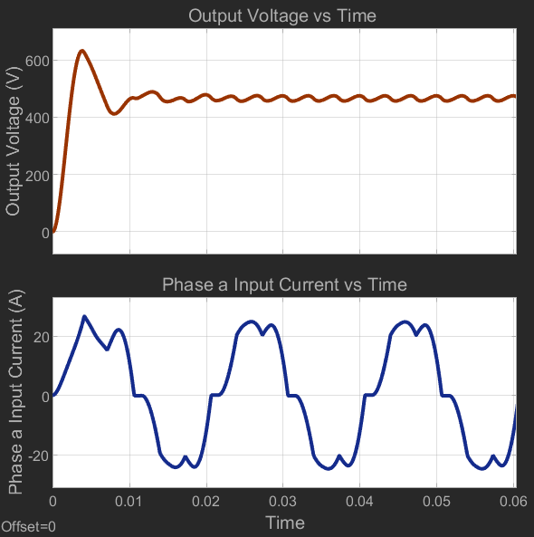
THREE PHASE DIODE RECTIFIER

Slide 9
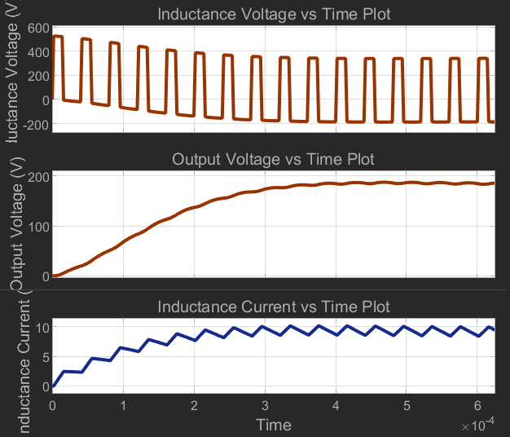
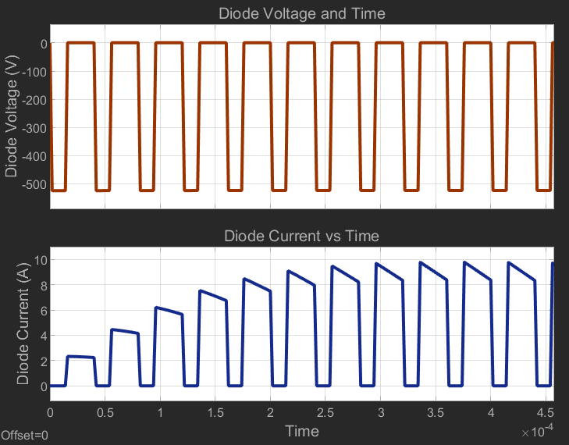
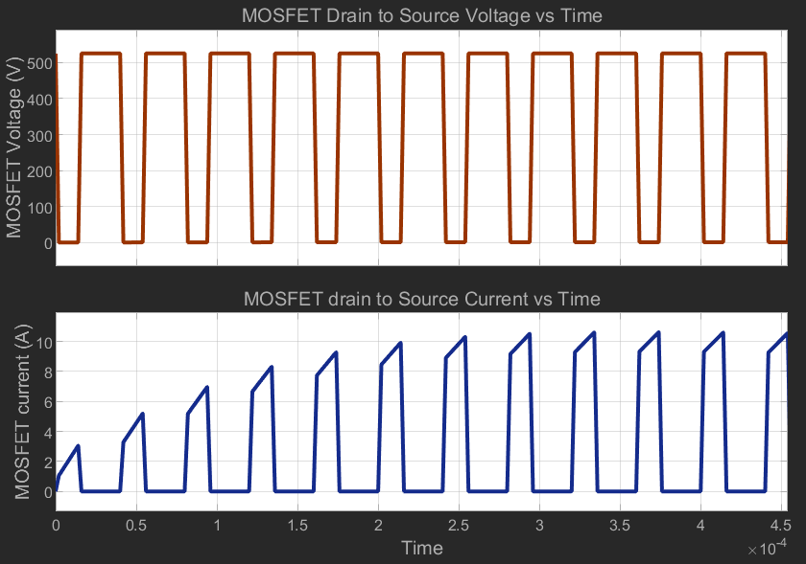
BUCK CONVERTER

Slide 10
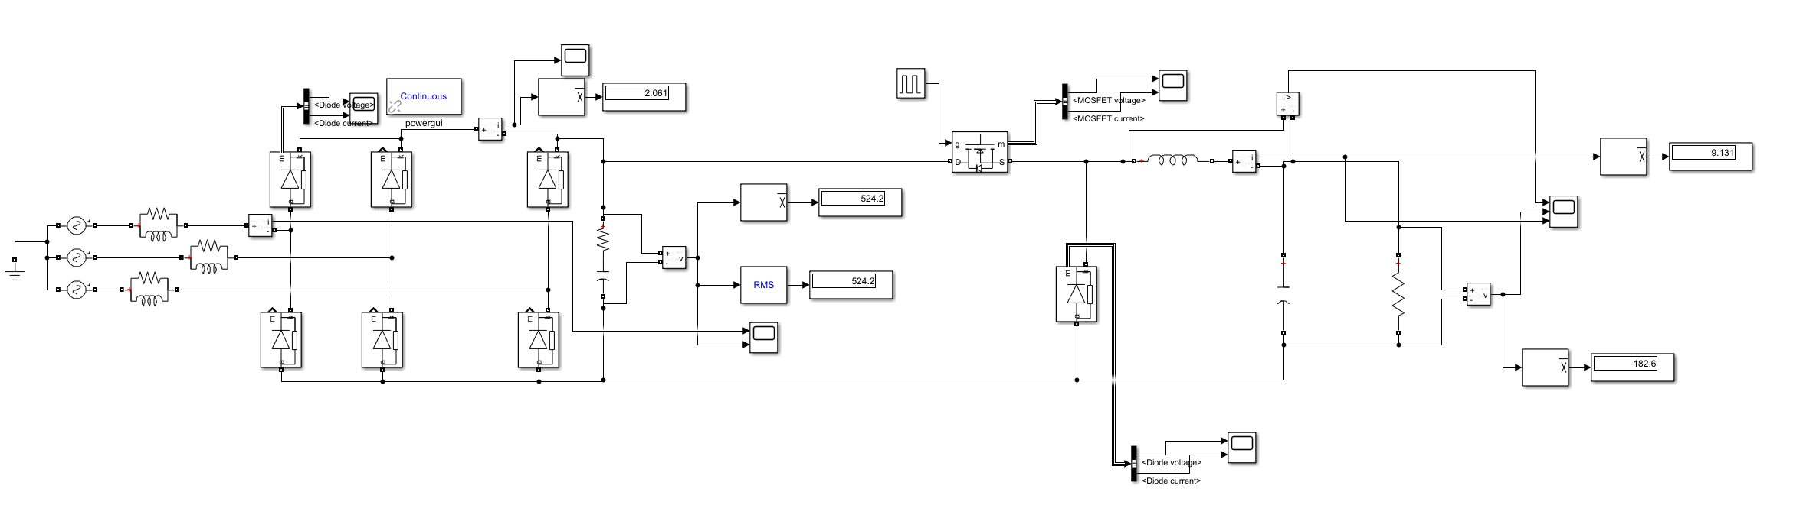
THREE PHASE DIODE RECTIFIER & BUCK CONVERTER

Slide 11
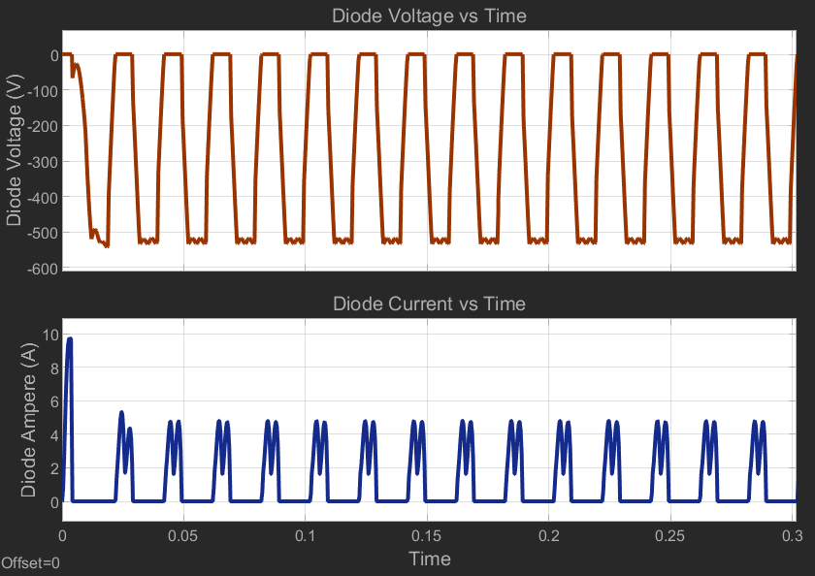
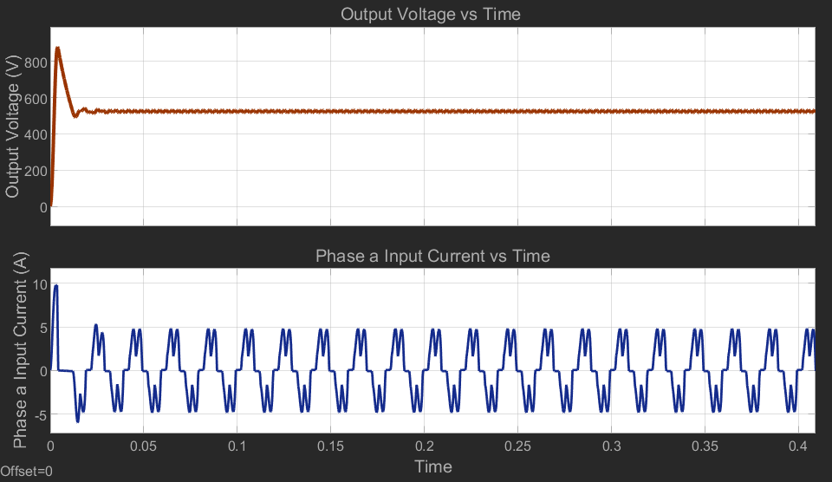
THREE PHASE DIODE RECTIFIER & BUCK CONVERTER
Three Phase Rectifier Diode

Slide 12
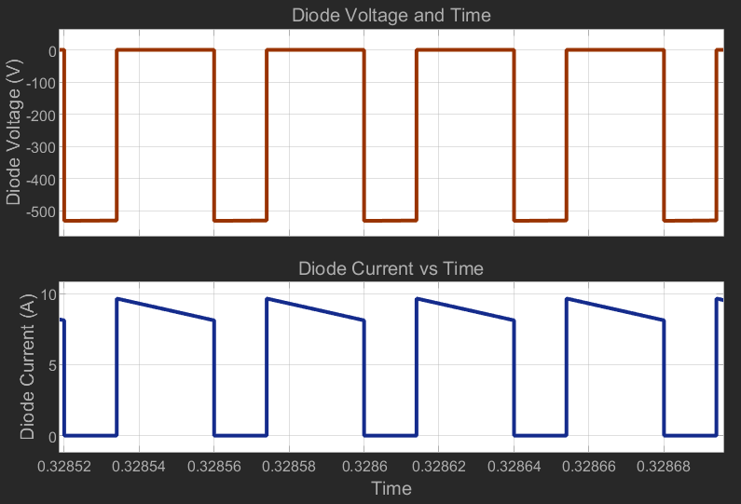
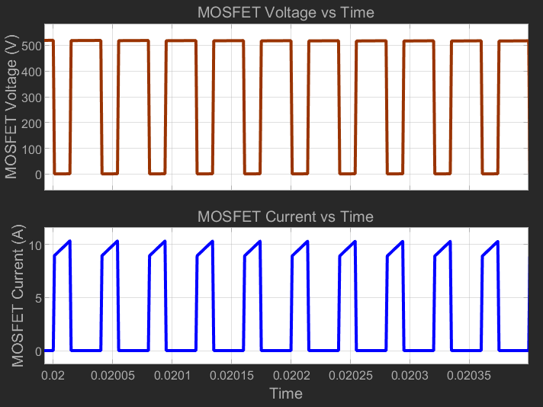
THREE PHASE DIODE RECTIFIER & BUCK CONVERTER
BUCK CONVERTER Diode
BUCK CONVERTER MOSFET

Slide 13
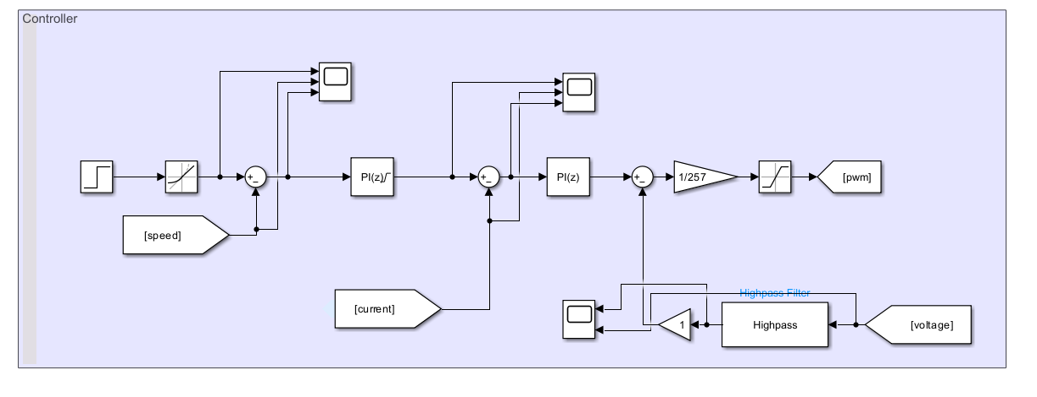
SPEED CONTROL MODEL
Controller

Slide 14
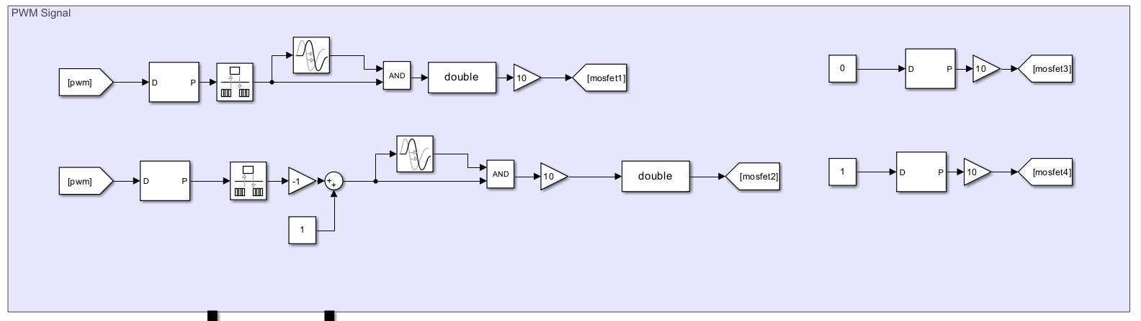
SPEED CONTROL MODEL
PWM Generator

Slide 15
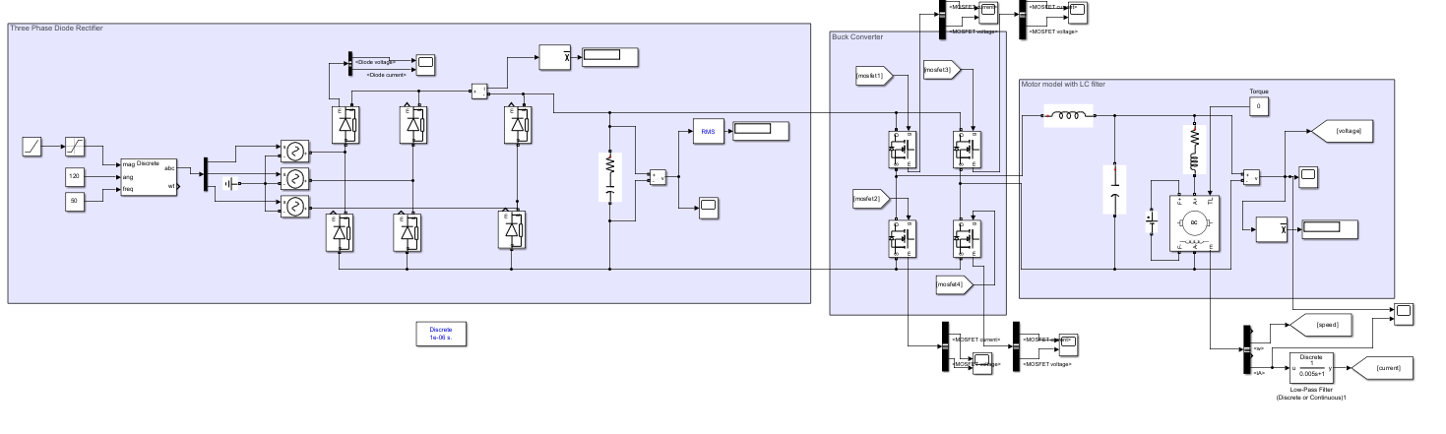
SPEED CONTROL MODEL
Rectifier & Buck Converter & LC Filter

Slide 16
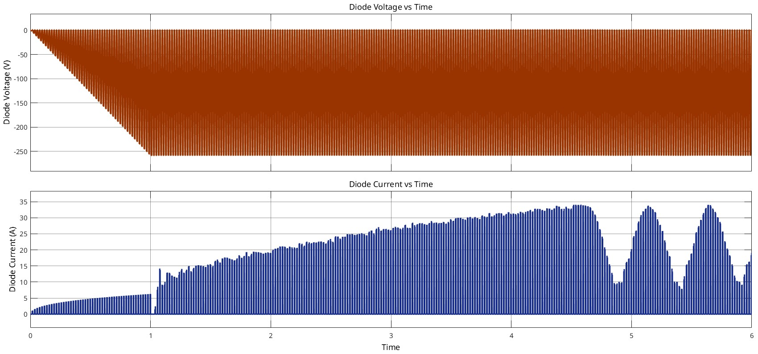
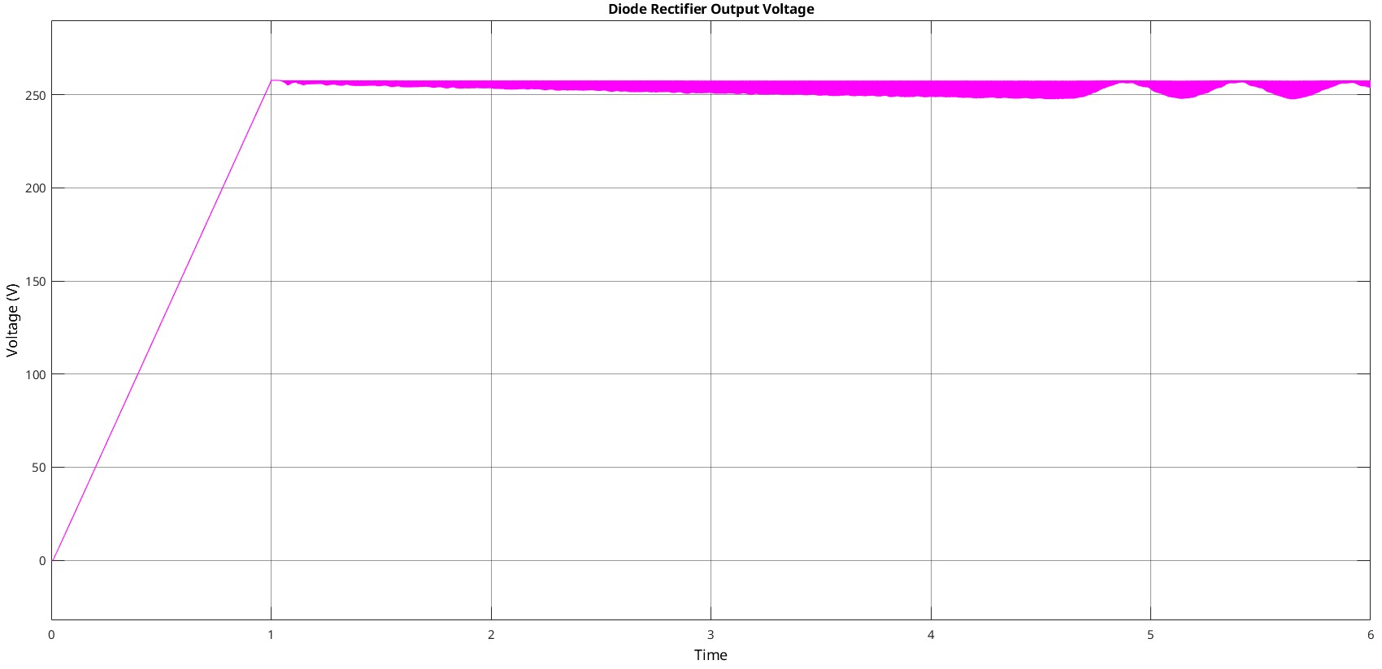
SPEED CONTROL MODEL

Slide 17
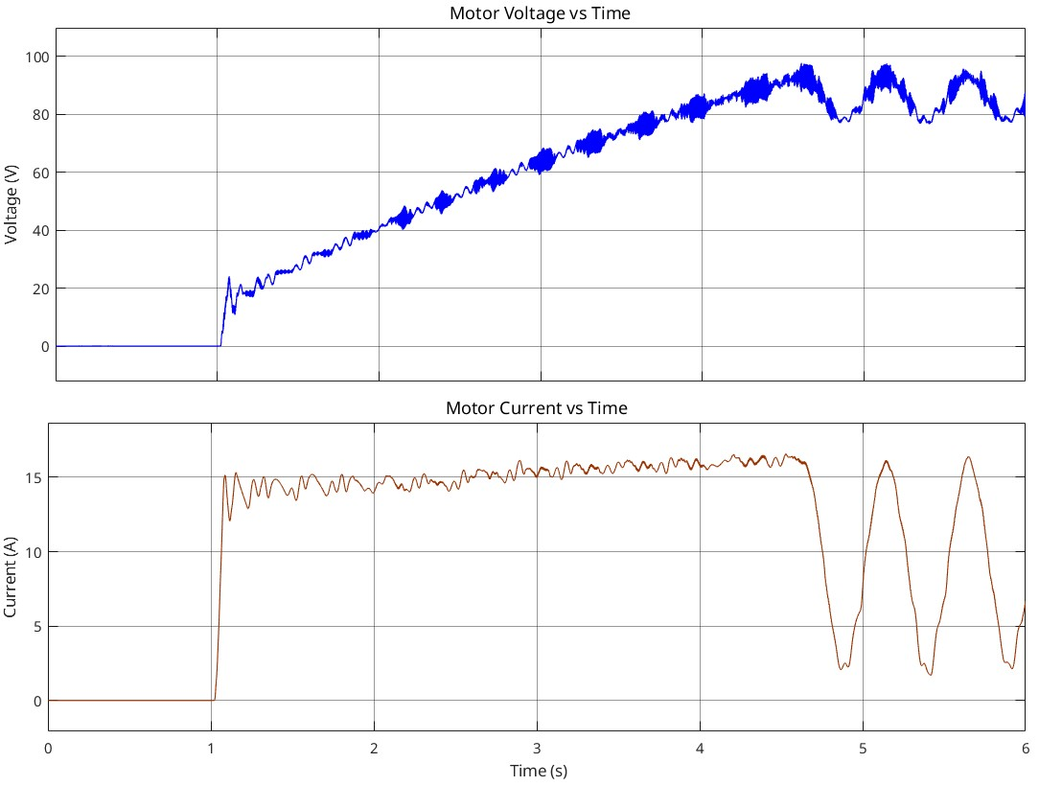
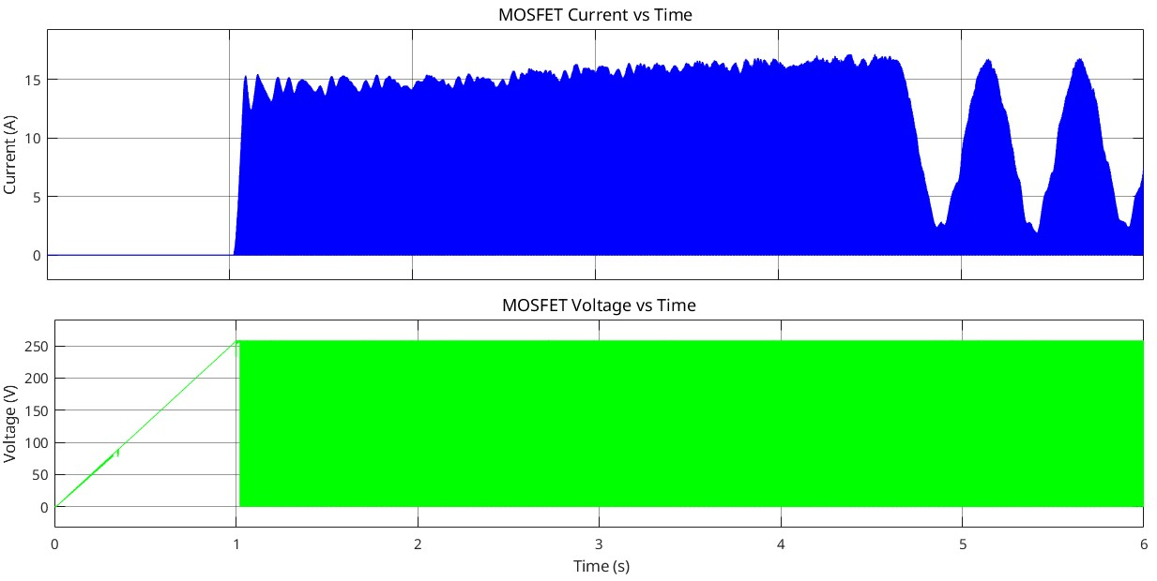
SPEED CONTROL MODEL

Slide 18
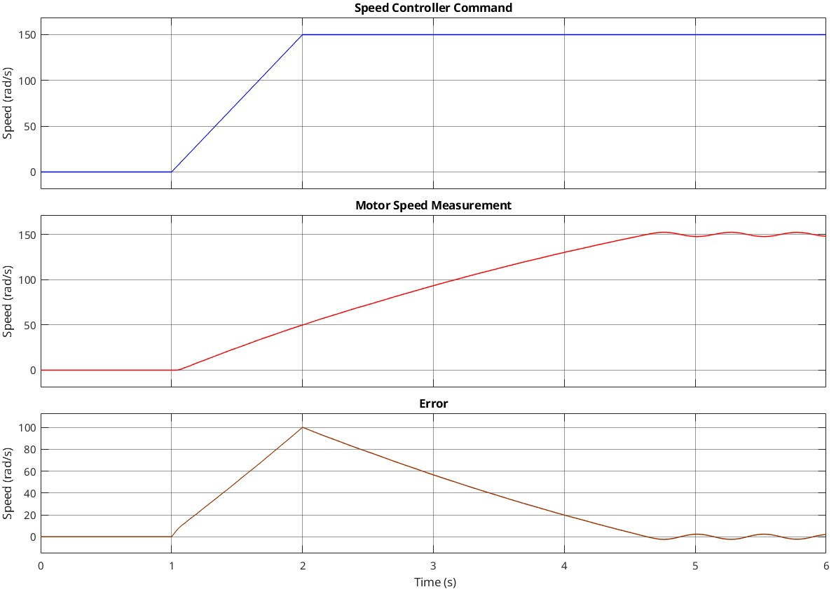
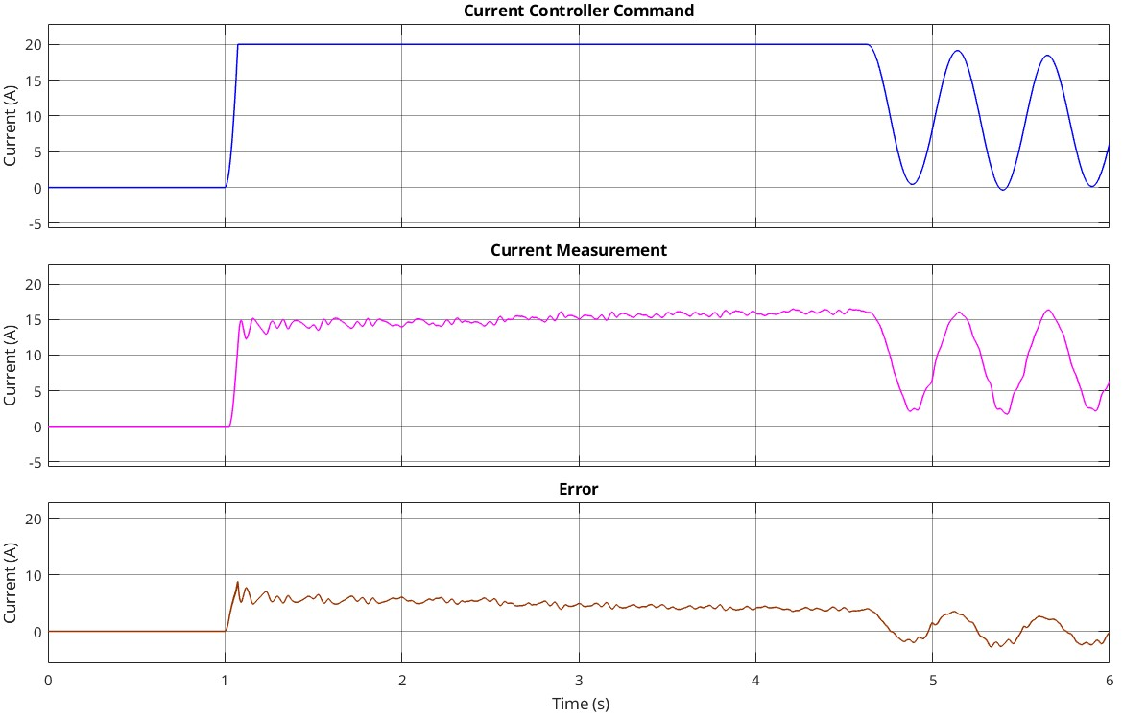
SPEED CONTROL MODEL

Slide 19
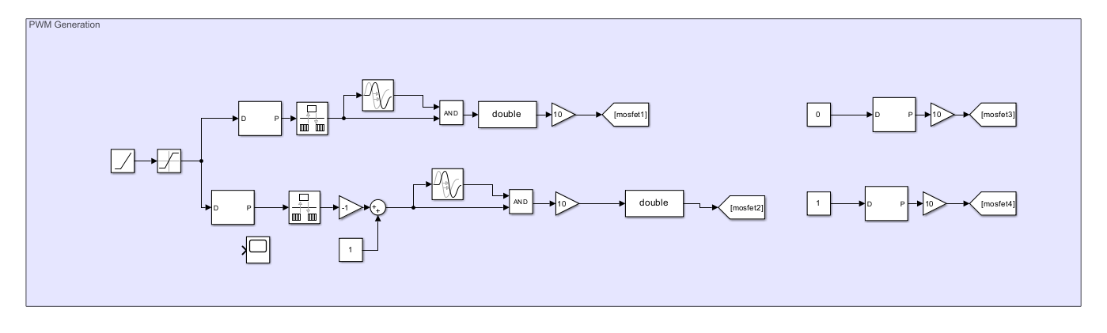
GENERATOR MODEL
PWM Generator

Slide 20
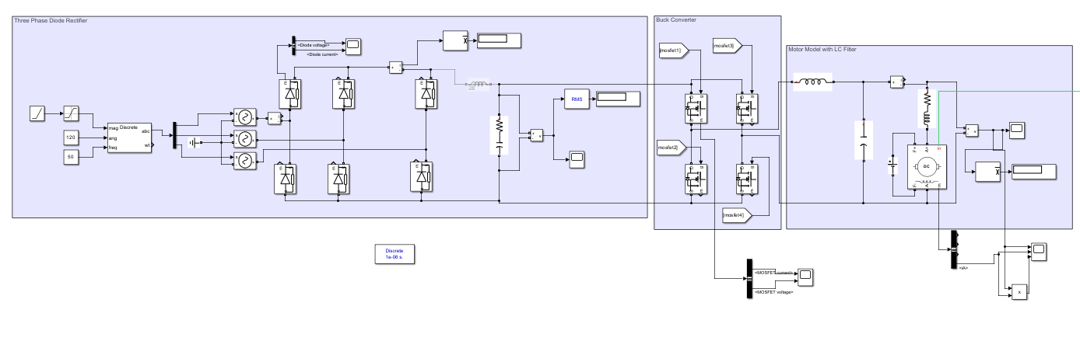
GENERATOR MODEL
Rectifier & Buck Converter & LC Filter

Slide 21
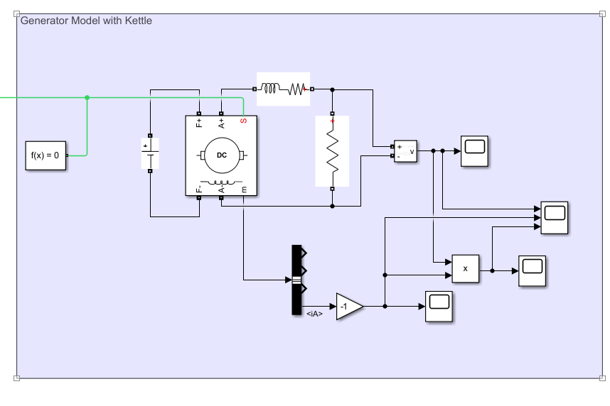
GENERATOR MODEL
Kettle Model

Slide 22
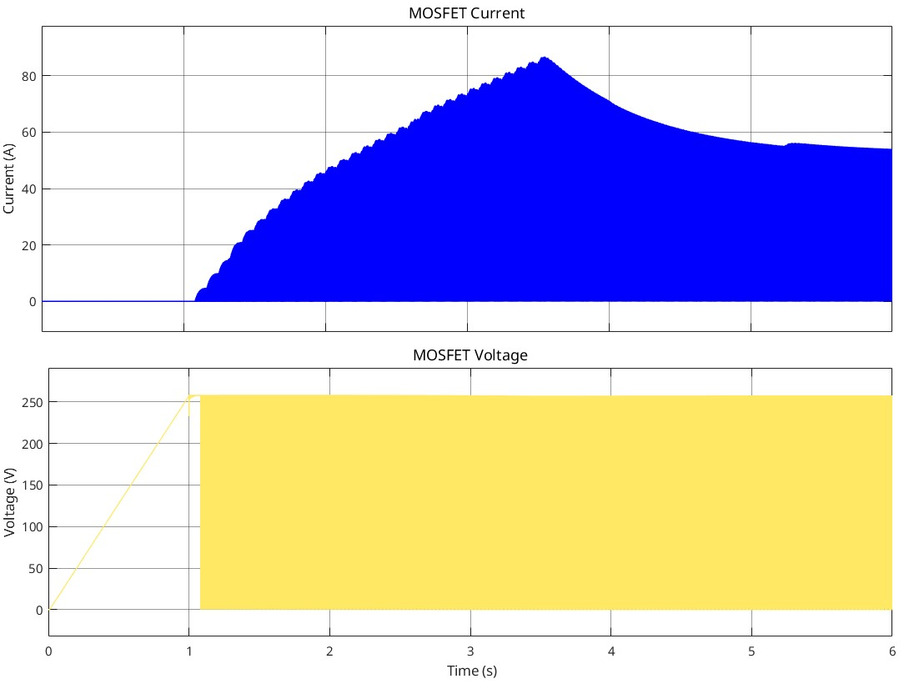
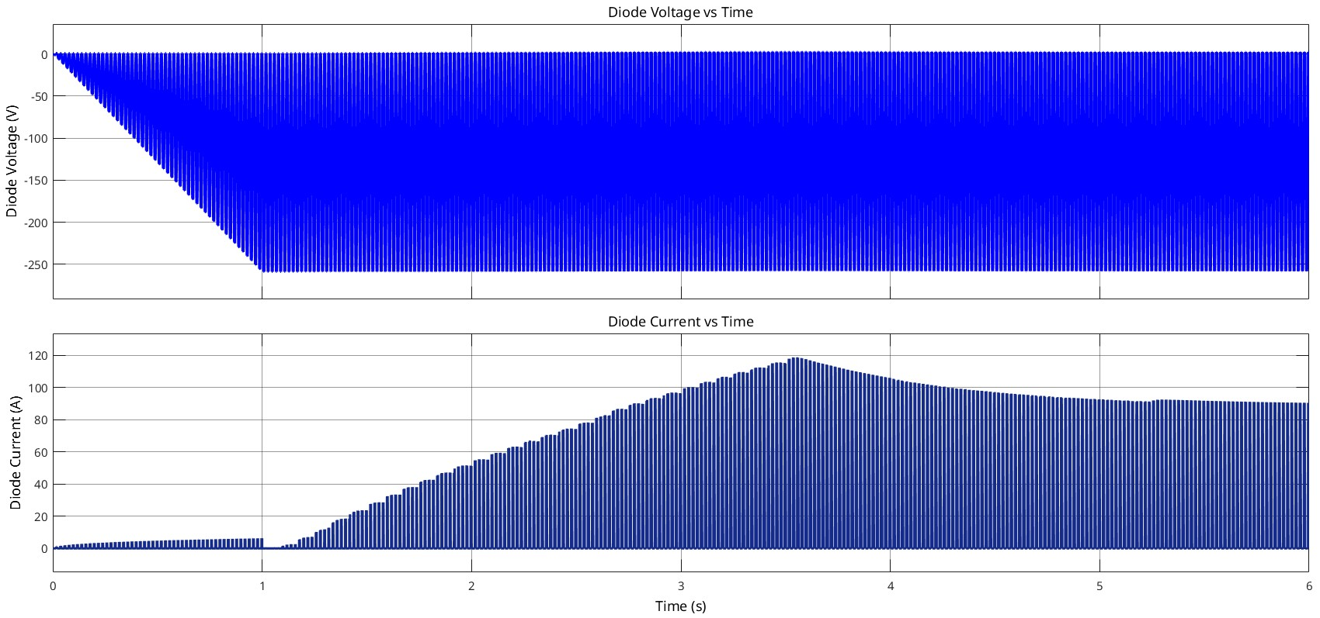
GENERATOR MODEL

Slide 23
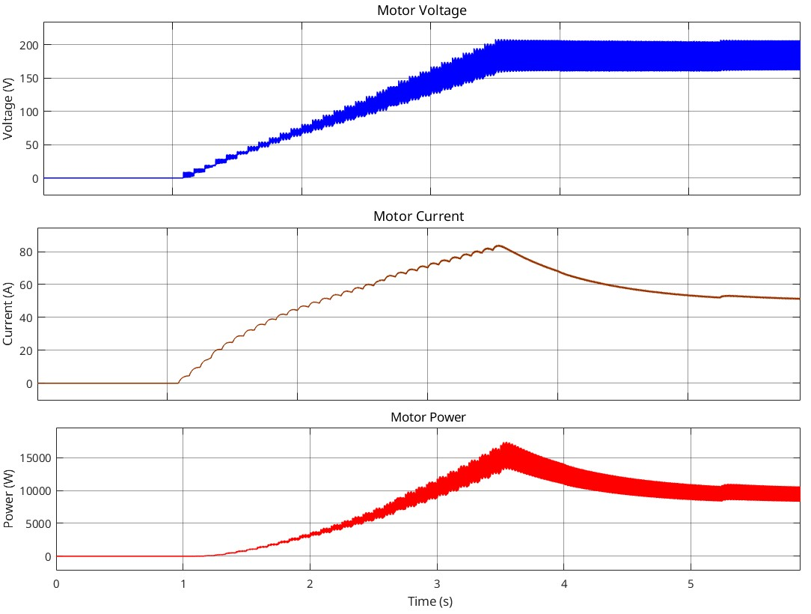
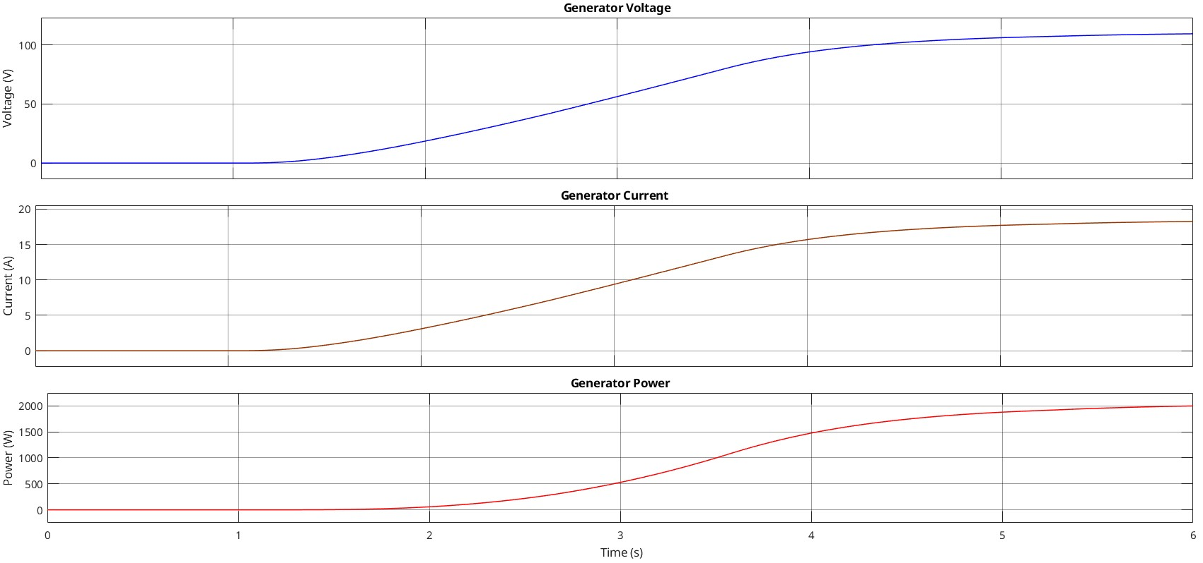
GENERATOR MODEL

Slide 24
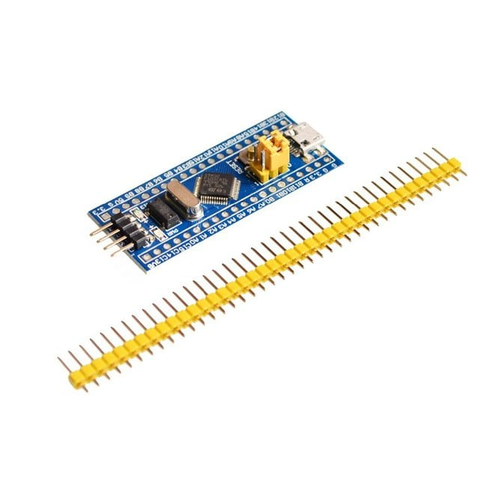
COMPONENT SELECTION
PWM Generator - STM32
High-frequency PWM generation
Real-time processing
Suitable for motor control applications

Slide 25
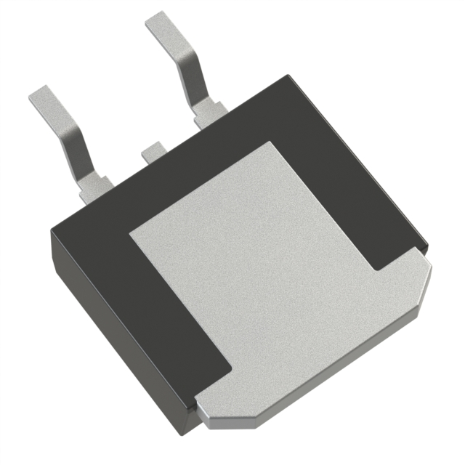
COMPONENT SELECTION
MOSFET - NTB150N65S3HF
650 V
24 A
121 mΩ RDS(on)
Fast switching (19 ns rise, 14 ns fall)
Low power dissipation (0.77 W/s calculation)

Slide 26
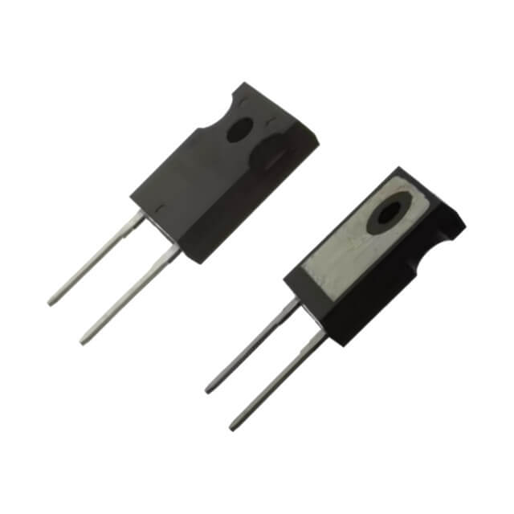
COMPONENT SELECTION
Diode - BYC80MW-650PT2Q
Handle 300 V and 45 A safely
Key factors: Cost, performance (low power dissipation)
Choice based on power dissipation <20W and cost-effectiveness

Slide 27
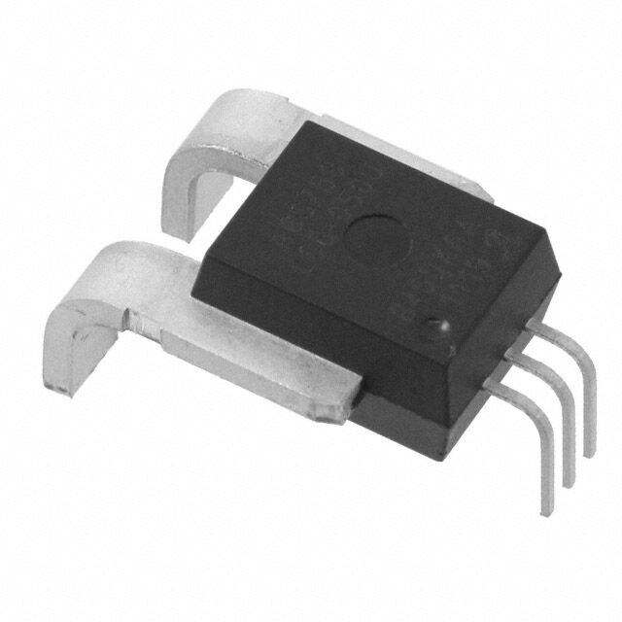
COMPONENT SELECTION
Current Sensor
±50 A range, 50 mV/A sensitivity
Fast response (6.5 µs)
80 kHz bandwidth,
424 V RMS isolation
Accurate monitoring of currents in 20–22 A range
Real-time performance and safety (isolation)

Slide 28
FUTURE WORK
Implement the design in hardware and validate results experimentally.
Optimize generator mode performance to prevent overcurrent issues.
Explore further component refinements for enhanced system robustness.

Slide 29
THANK YOU FOR YOUR ATTENTION

